Slide 1
Market Structures
Meaning, Determinants, Types of Competitive Structures & Features

Slide 2
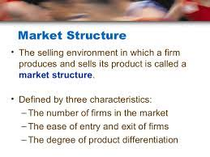
What is Market Structure?

Slide 3
The determination of price is affected by the competitive structure of the market. This is because the firm operates in a market and not in isolation

Slide 4
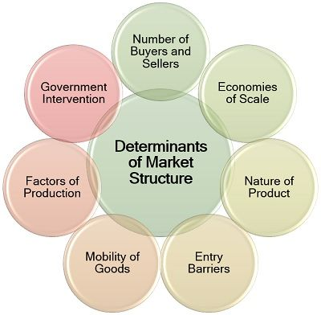
Determinants of Market Structure

Slide 5
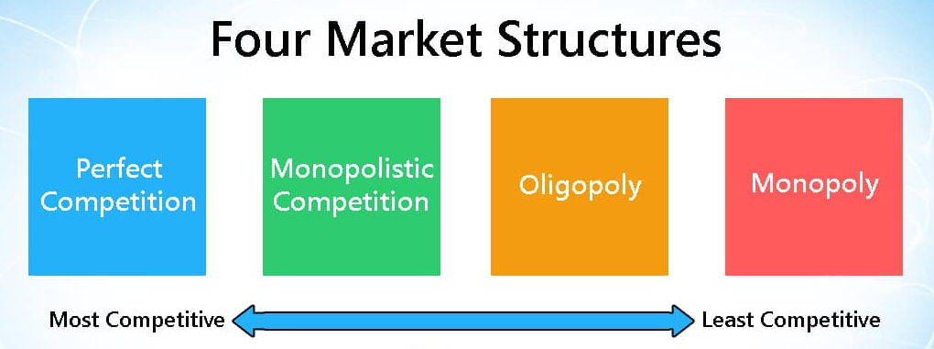
Types of Market Structures

Slide 6
Perfect Competition
Meaning, Features, Examples.

Slide 7
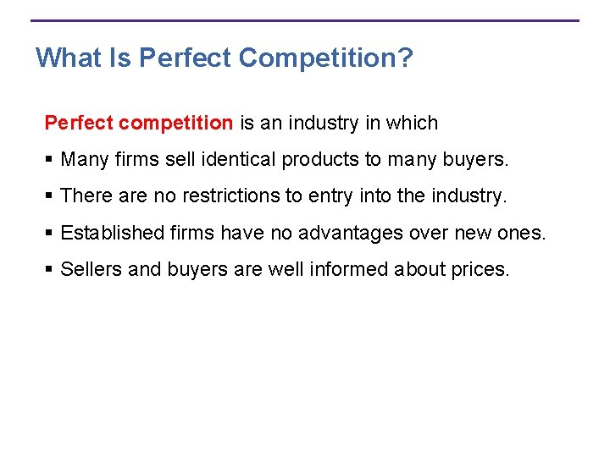

Slide 8
Features of Perfect Competition
1. Large Number of Buyers and Sellers
2. Existence of Homogeneous Product
3. Absence of Artificial Restrictions
4. Free Entry and Exit for Firms
5. Perfect Knowledge on the part of Buyers and Sellers
6. Perfect Mobility of Factors of Production
7. Non-existence of Transportation Costs.
Perfect Competition describes a market structure whose assumption are strong and therefore, unlikely to exist in most real-world markets.

Slide 9

Examples of Perfect Competition

Slide 10
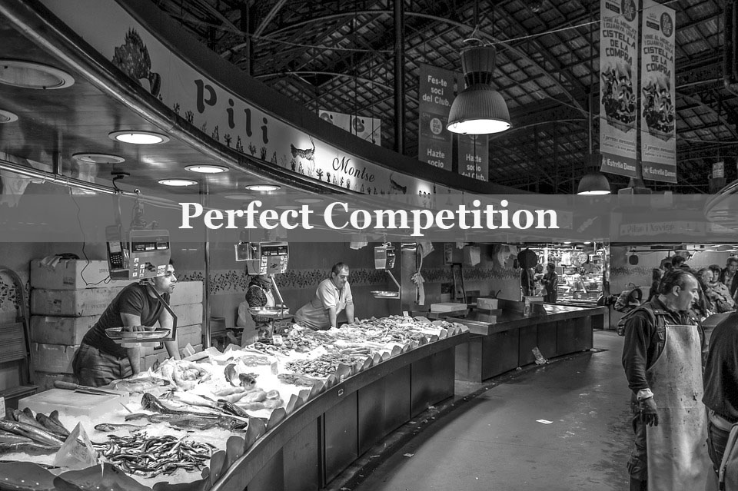

Slide 11

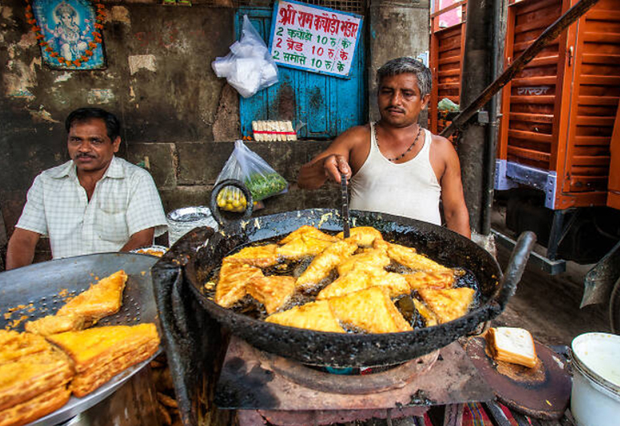

Slide 12
Monopoly
Meaning, Features, Examples.

Slide 13
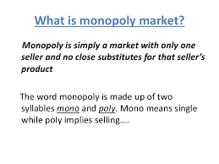

Slide 14
Features of Monopoly
1. There is only one Seller of a particular good or service
2. Rivalry from the producers of substitutes is so remote as to
be insignificant. This implies that the cross-elasticity of
demand between the monopolist’s product and any other
product is low.
3. As a result, the monopolist is in a position to set the price
himself. In fact, monopoly implies market power.

Slide 15

Examples of Monopoly

Slide 16
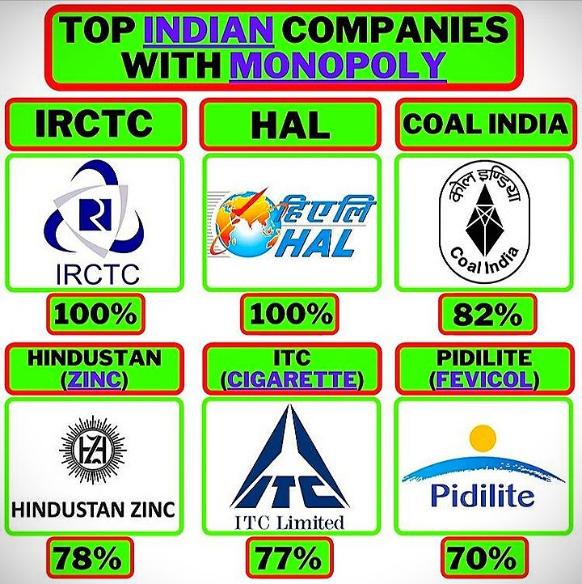

Slide 17
Monopolistic Competition
Meaning, Features, Examples.

Slide 18
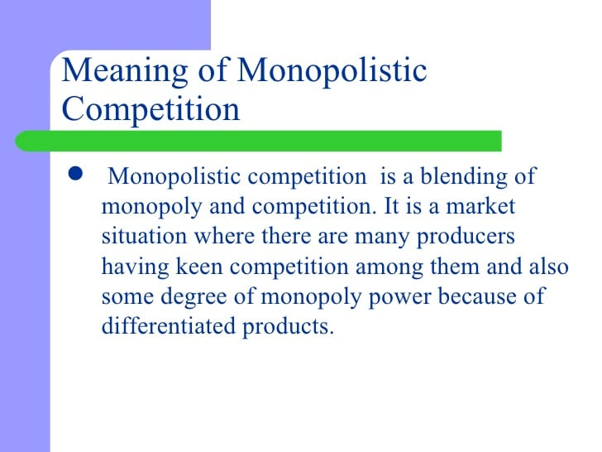

Slide 19
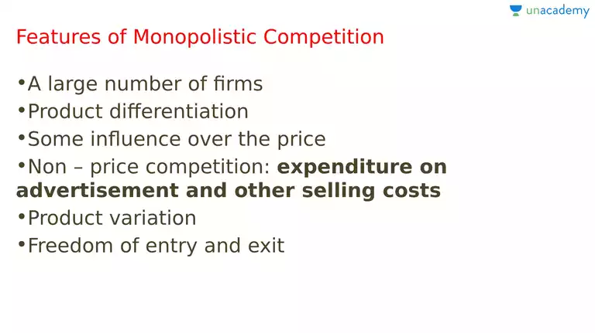

Slide 20
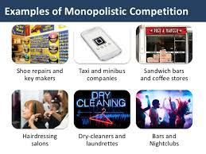

Slide 21
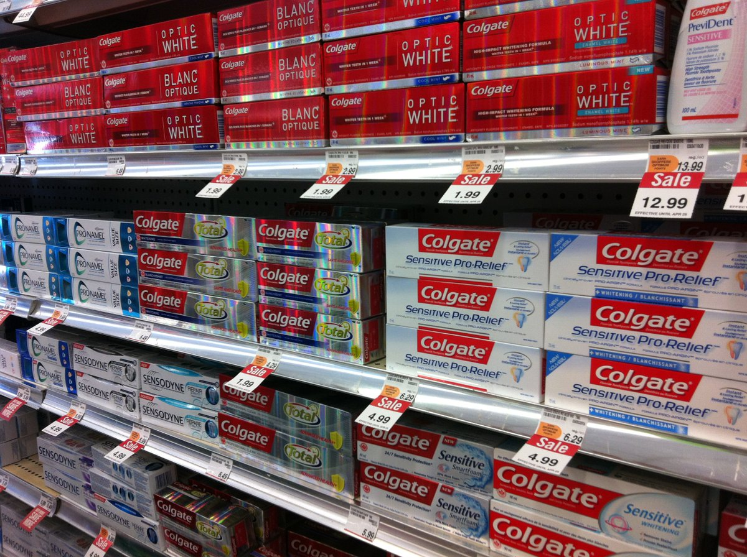
Examples of Monopolistic Competition

Slide 22
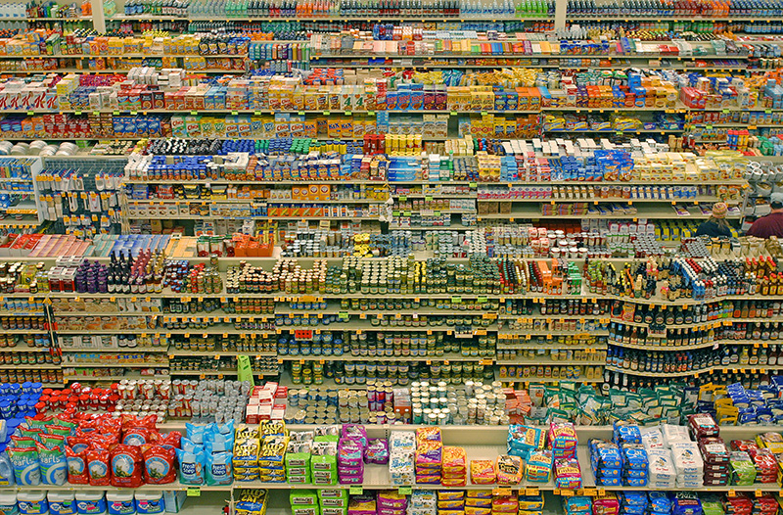

Slide 23
Oligopoly
Meaning, Features, Examples.

Slide 24
Meaning of Oligopoly
The term “Oligopoly” is derived from two Greek words:
“Oligos” – meaning a few, “Pollen” – meaning to sell.
Oligopoly is that form of imperfect competition where there are a
few firms in the market, producing either an homogenous product
or producing products which are close but not perfect substitutes of
each other.

Slide 25
Characteristics of Oligopoly
1. Interdependence
2. Indeterminateness of Demand Curve
3. Conflicting Attitudes of Firms
4. Element of Monopoly
5. Price Rigidity

Slide 26
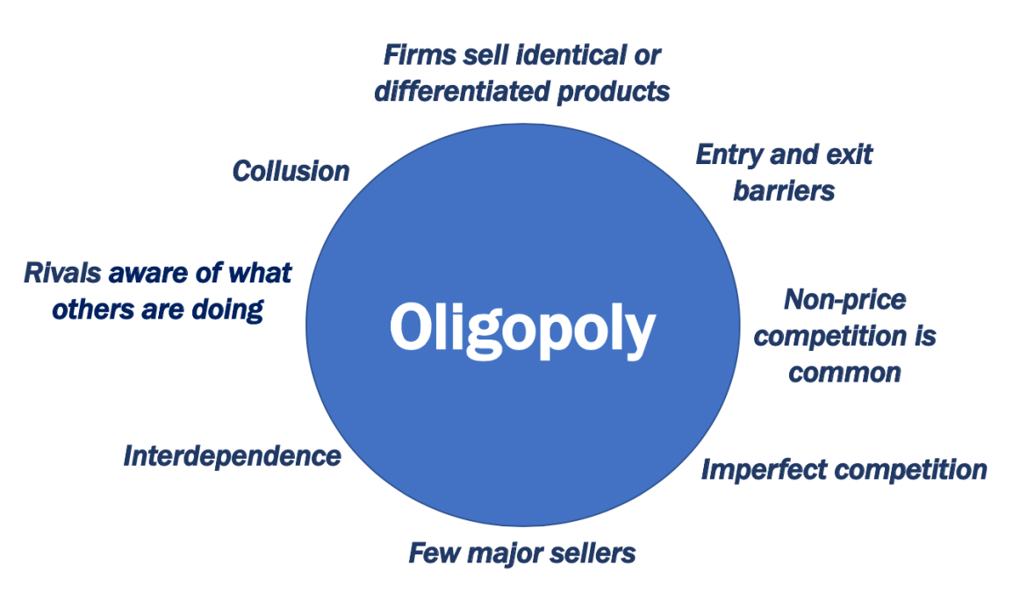

Slide 27
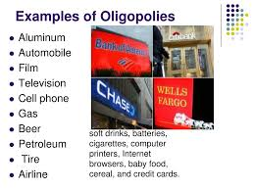

Slide 28
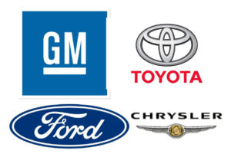
Examples of Oligopoly

